Slide 1
Minimizing a [Loss] Function:
Optimizers

Slide 2
Popular optimization methods
Gradient descent
AdaGrad (2011)
RMSProp (2012)
Adam (2015)

Slide 3
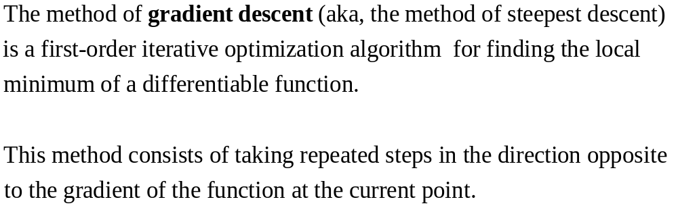
Gradient descent (1)
Ref.: Wikipedia

Slide 4
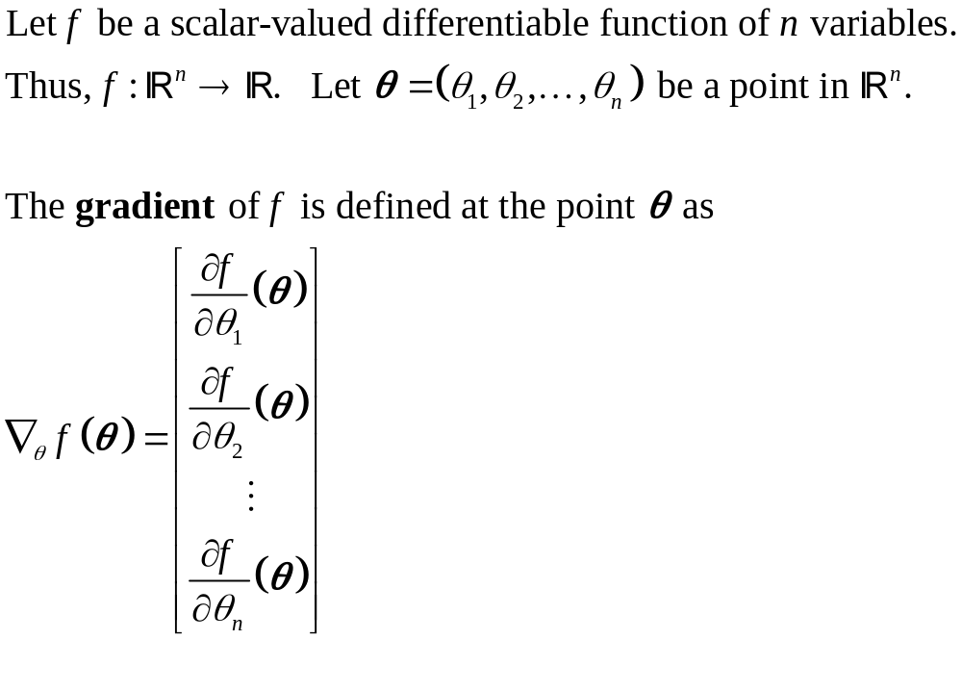
Gradient (1)
Ref.: Wikipedia

Slide 5
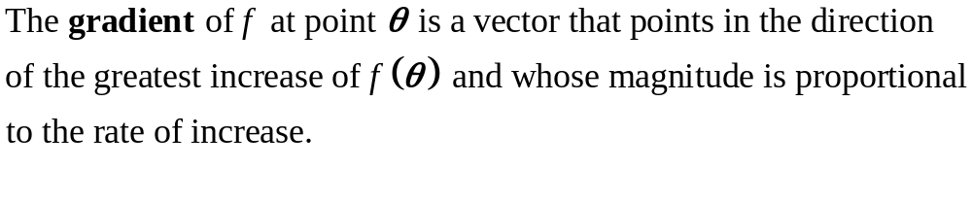
Gradient (2)
Ref.: Wikipedia

Slide 6
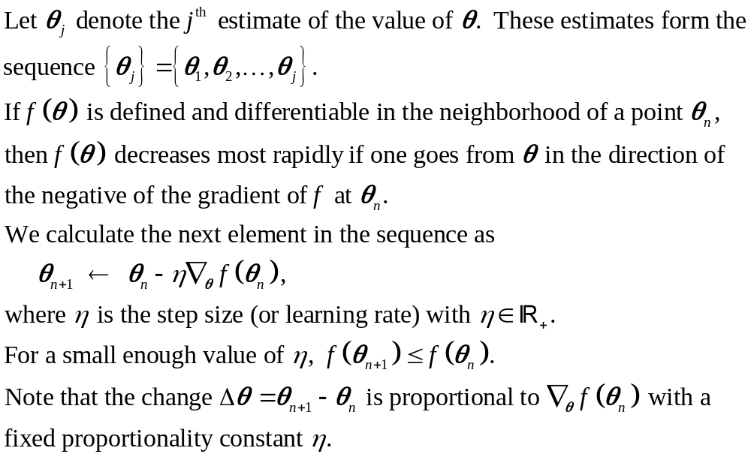
Gradient descent (2)
Ref.: Wikipedia

Slide 7
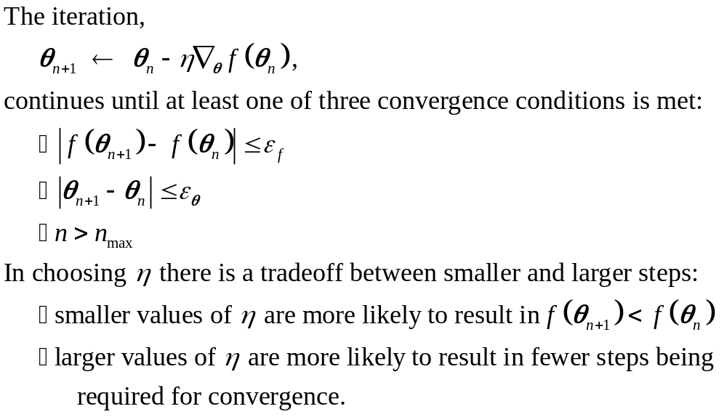
Gradient descent (3)
Ref.: Wikipedia

Slide 8
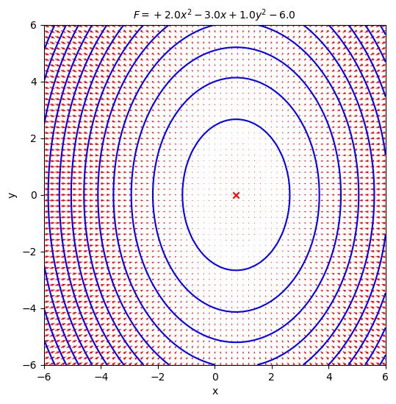
Example function (1)

Slide 9
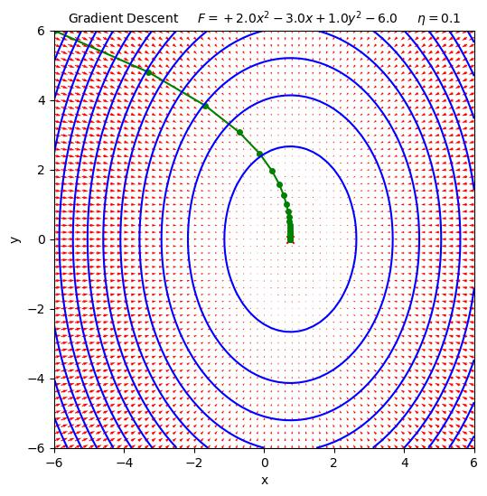
Gradient descent example (1)

Slide 10
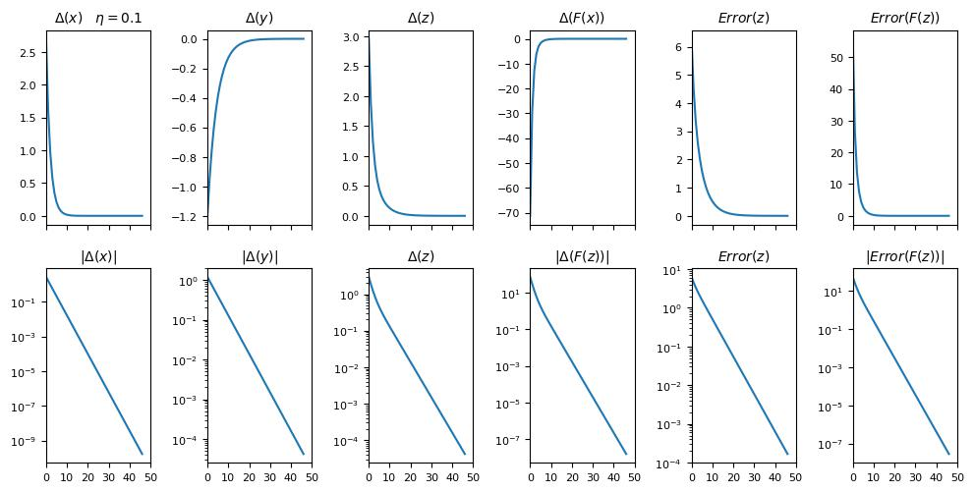
Gradient descent example (2)

Slide 11

Gradient descent example (3)

Slide 12
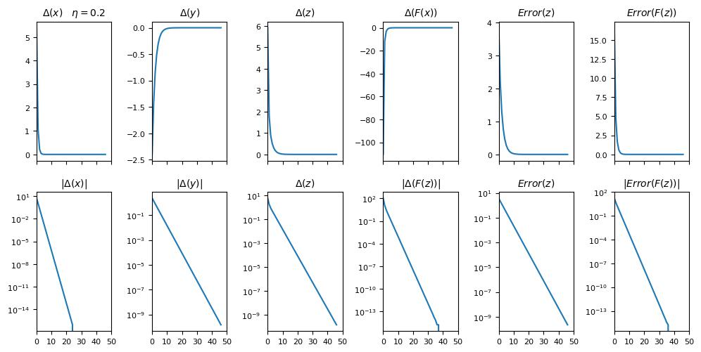
Gradient descent example (4)

Slide 13
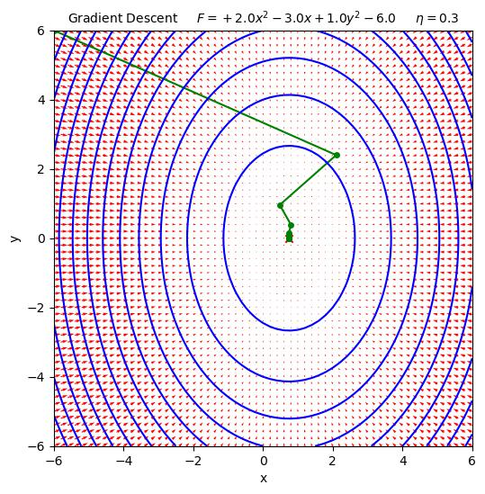
Gradient descent example (5)

Slide 14
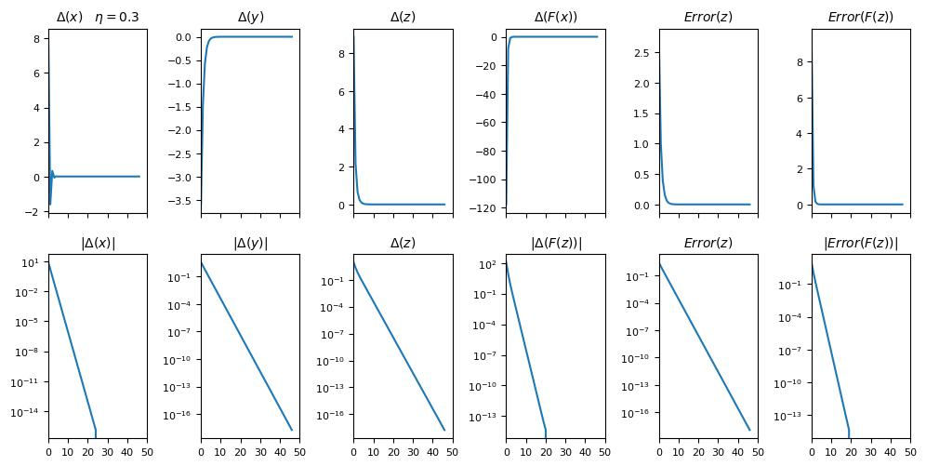
Gradient descent example (6)

Slide 15
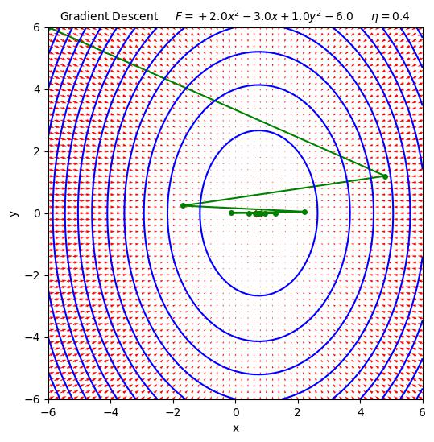
Gradient descent example (7)

Slide 16
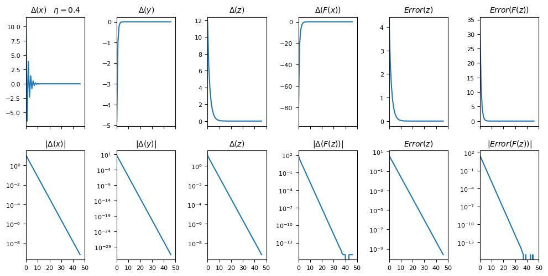
Gradient descent example (8)

Slide 17
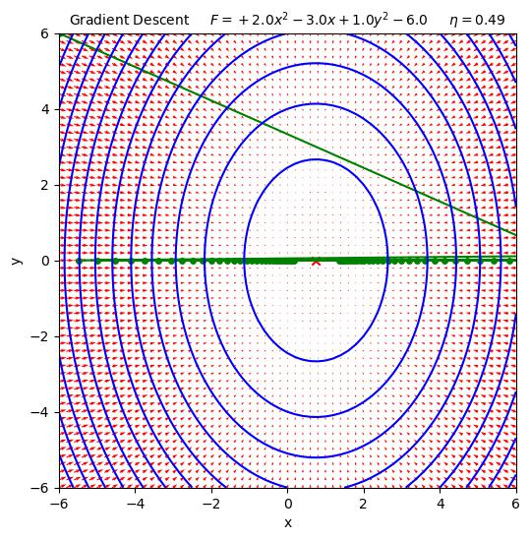
Gradient descent example (9)

Slide 18
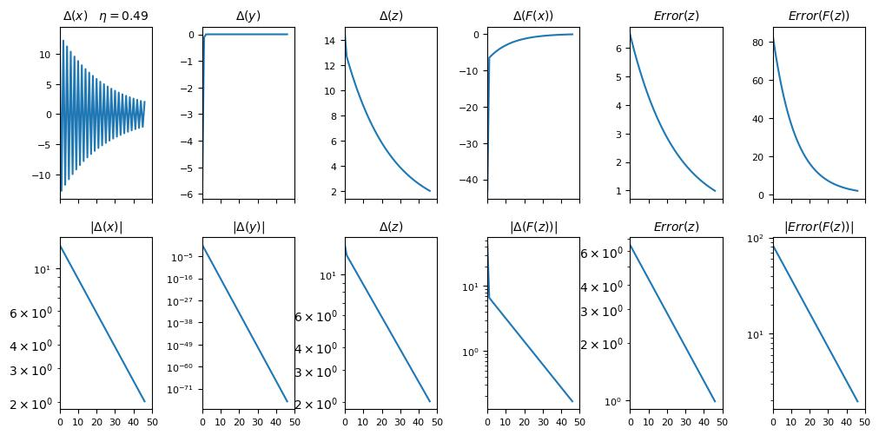
Gradient descent example (10)

Slide 19
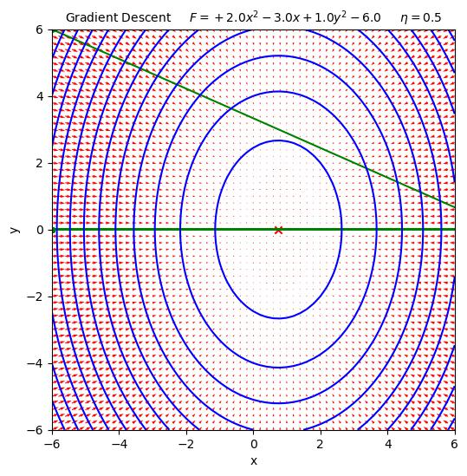
Gradient descent example (11)

Slide 20
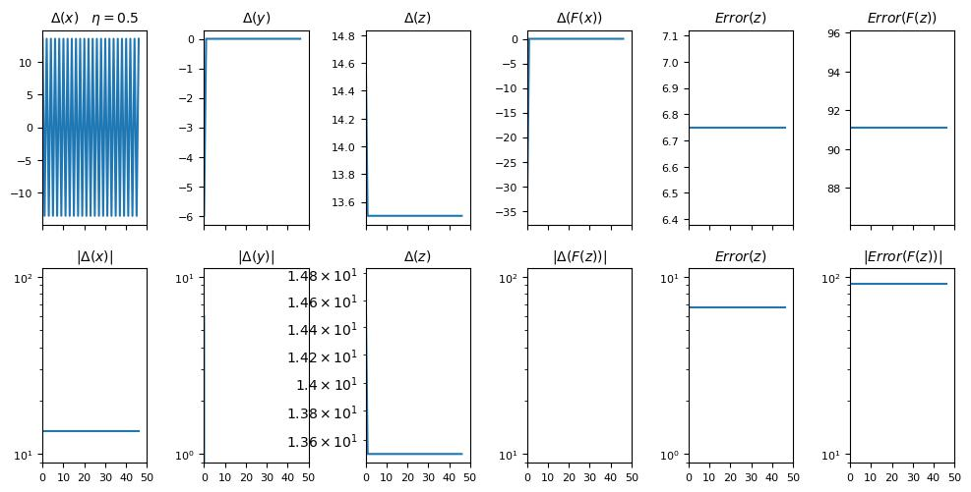
Gradient descent example (12)

Slide 21
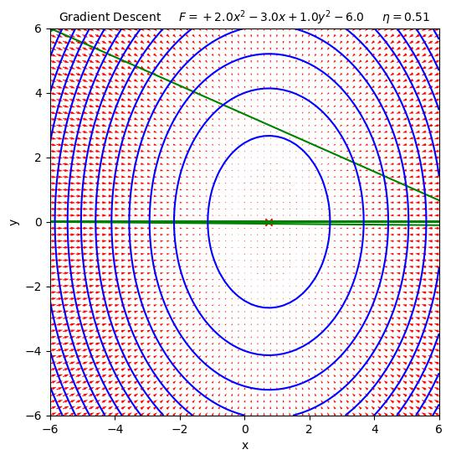
Gradient descent example (13)

Slide 22
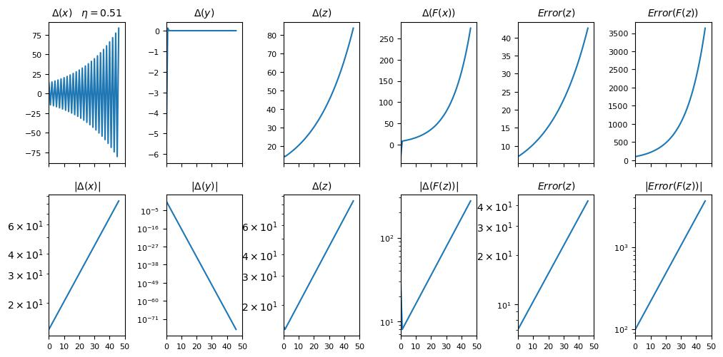
Gradient descent example (14)

Slide 23
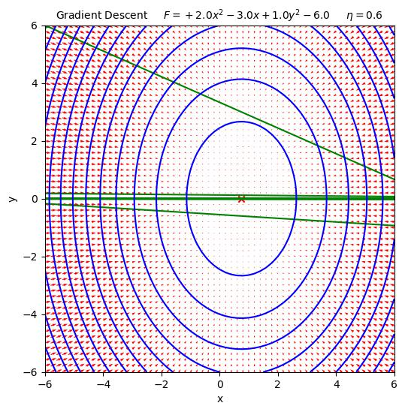
Gradient descent example (15)

Slide 24
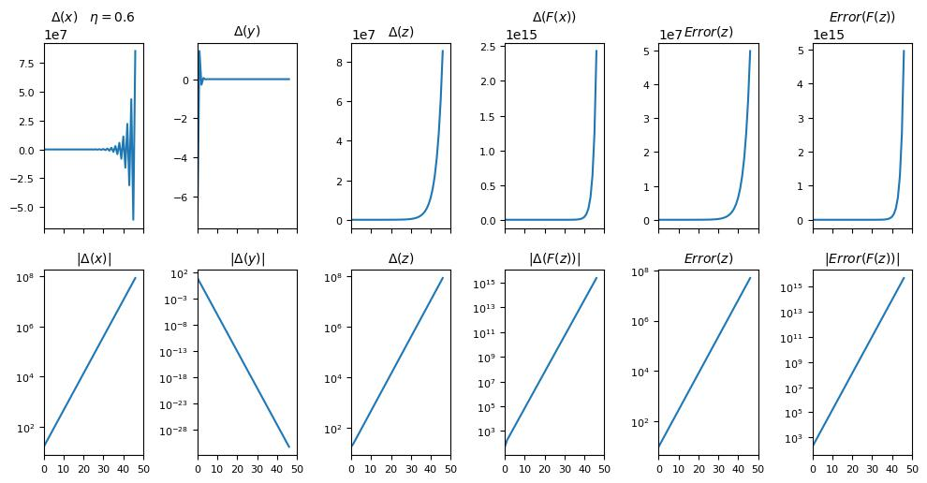
Gradient descent example (16)

Slide 25
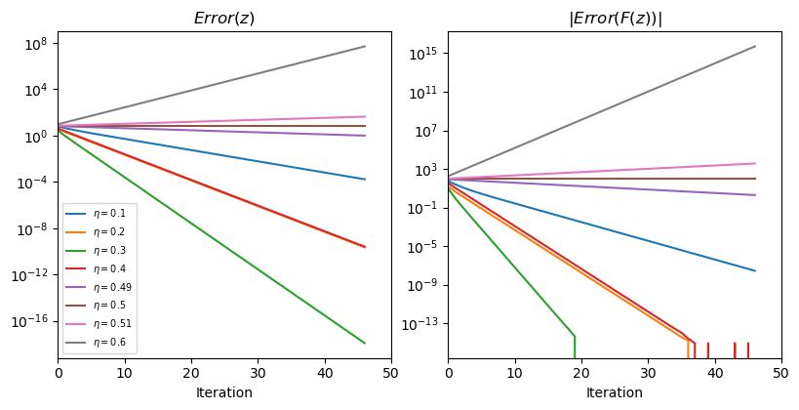
Gradient descent example (17)

Slide 26
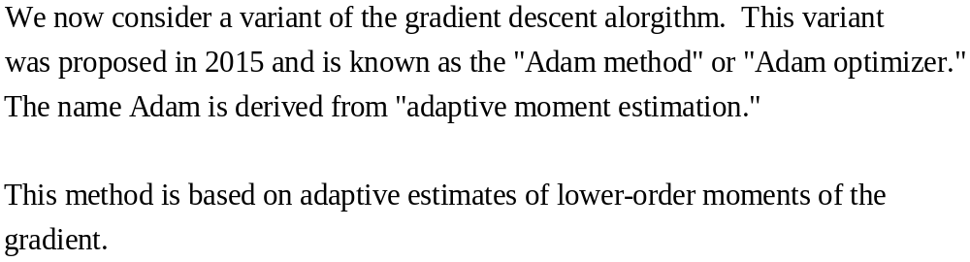
Adam optimizer (1)
Ref.: “Adam: A Method for Stochastic Optimization”

Slide 27
Adam optimizer (2)
Developed to handle large problems
  Many parameters
  Large datasets
Noisy or sparse gradients
Stochastic sampling of data during optimization
Ref.: “Adam: A Method for Stochastic Optimization”

Slide 28
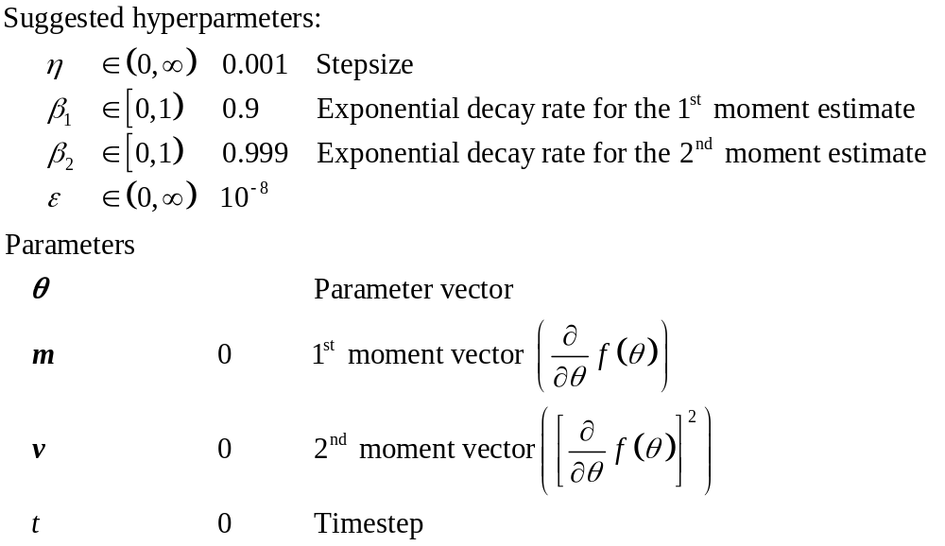
Adam optimizer (3)
Ref.: “Adam: A Method for Stochastic Optimization”

Slide 29
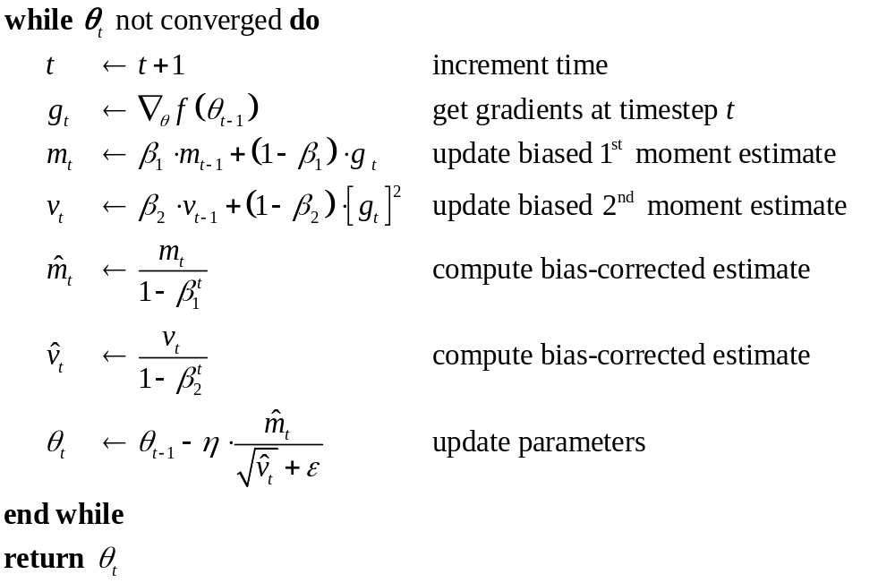
Adam optimizer (4)
Ref.: “Adam: A Method for Stochastic Optimization”

Slide 30
Example function (2)

Slide 31
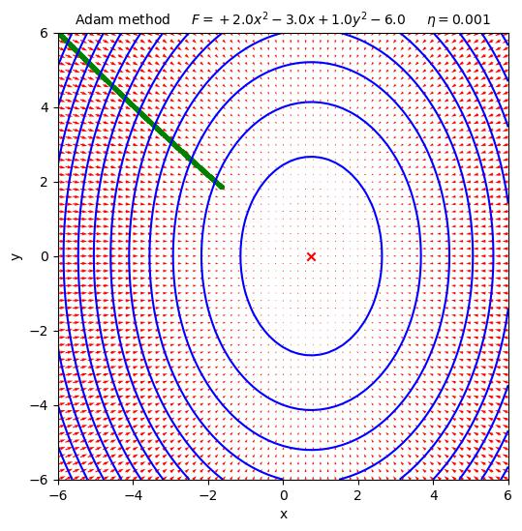
Adam method example (1)

Slide 32
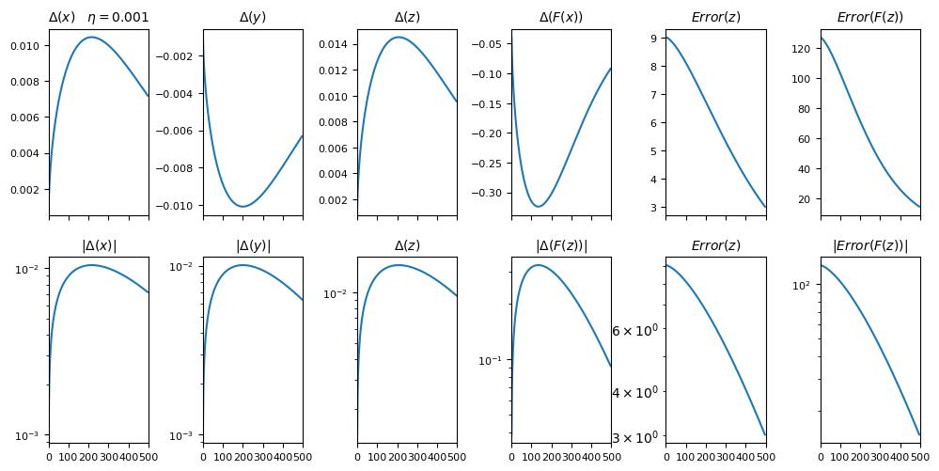
Adam method example (2)

Slide 33
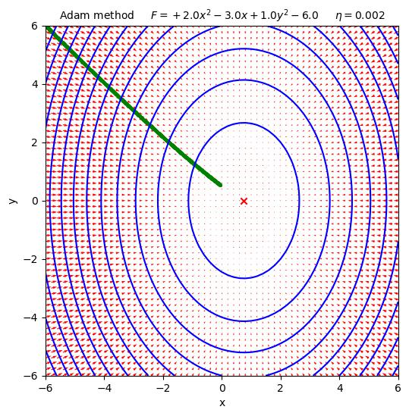
Adam method example (3)

Slide 34
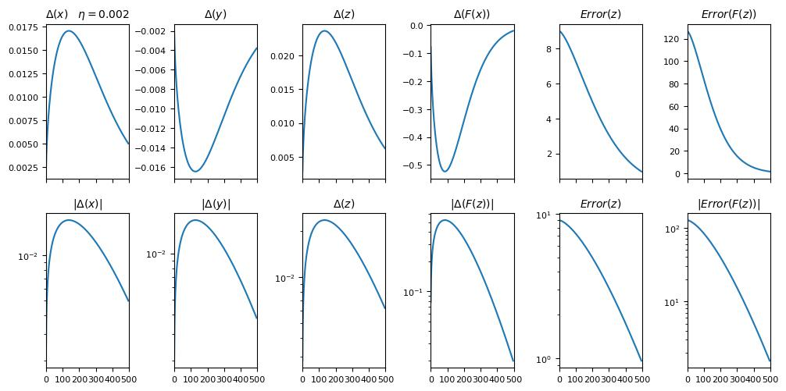
Adam method example (4)

Slide 35
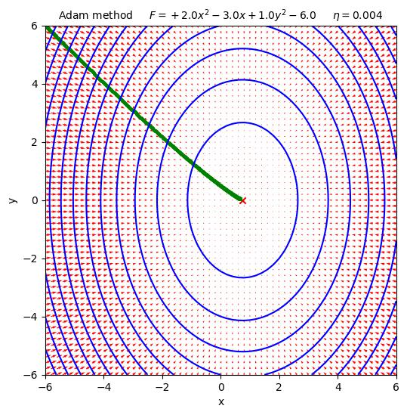
Adam method example (5)

Slide 36
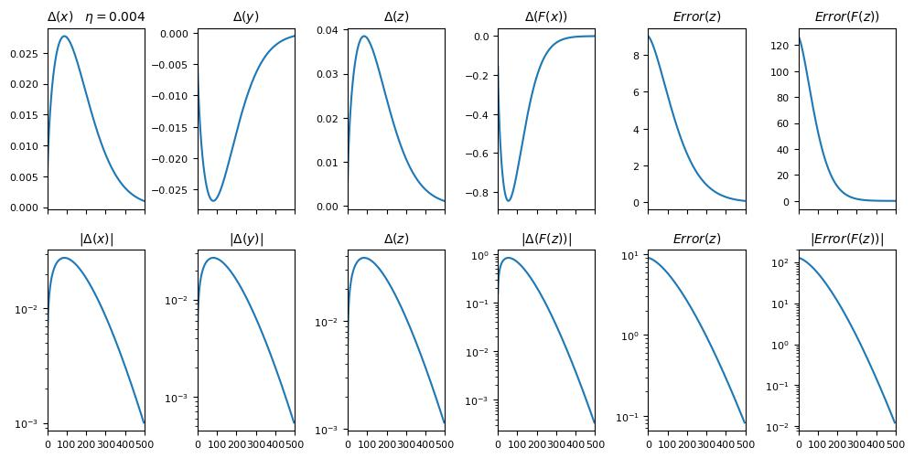
Adam method example (6)

Slide 37

Adam method example (7)

Slide 38
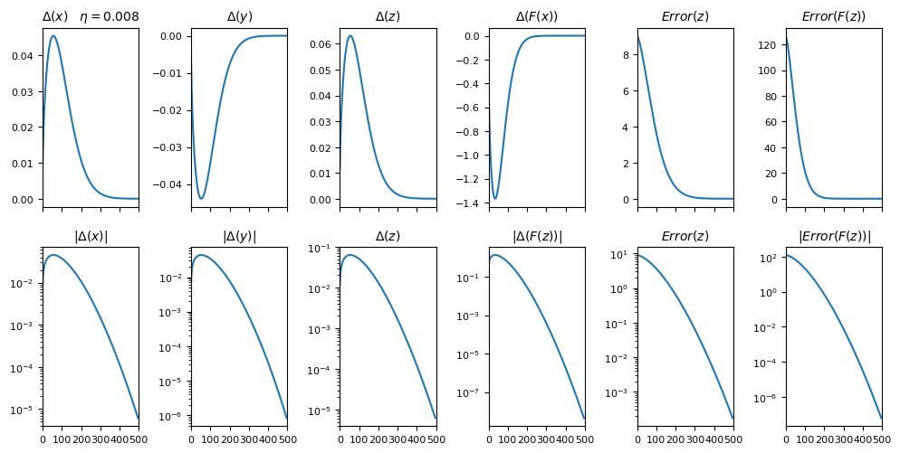
Adam method example (8)

Slide 39
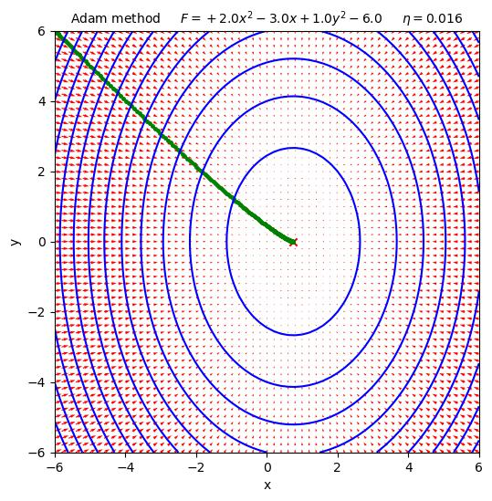
Adam method example (9)

Slide 40
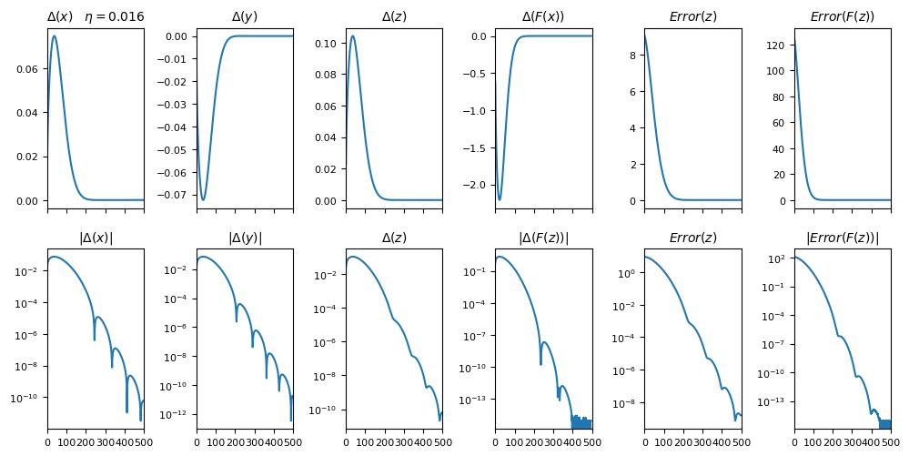
Adam method example (10)

Slide 41
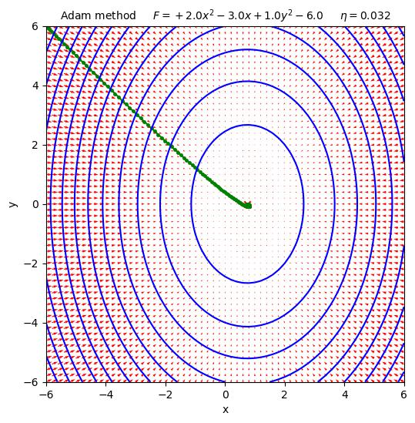
Adam method example (11)

Slide 42
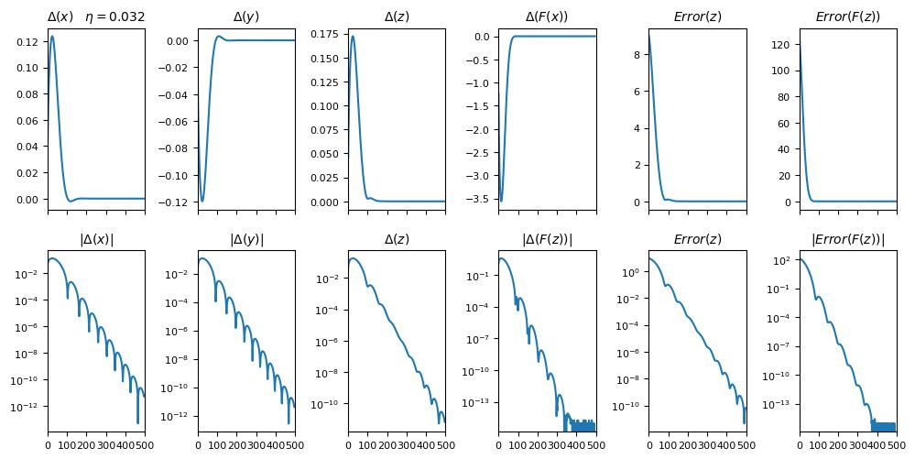
Adam method example (12)

Slide 43
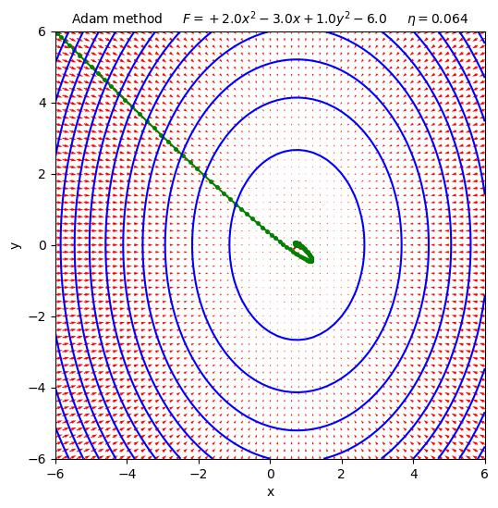
Adam method example (13)

Slide 44
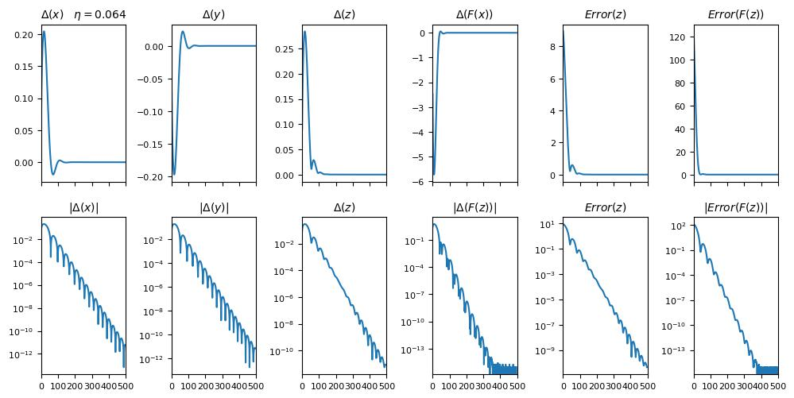
Adam method example (14)

Slide 45
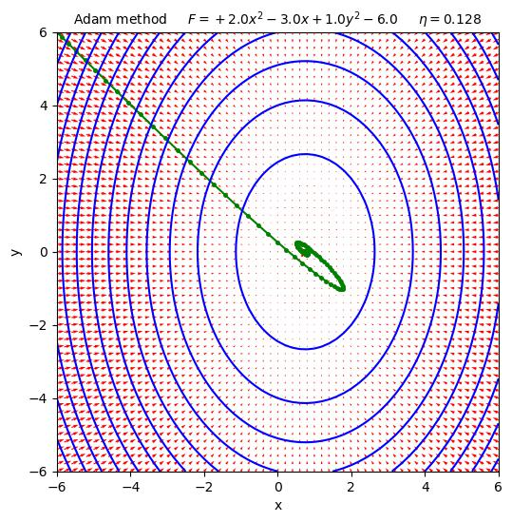
Adam method example (15)

Slide 46
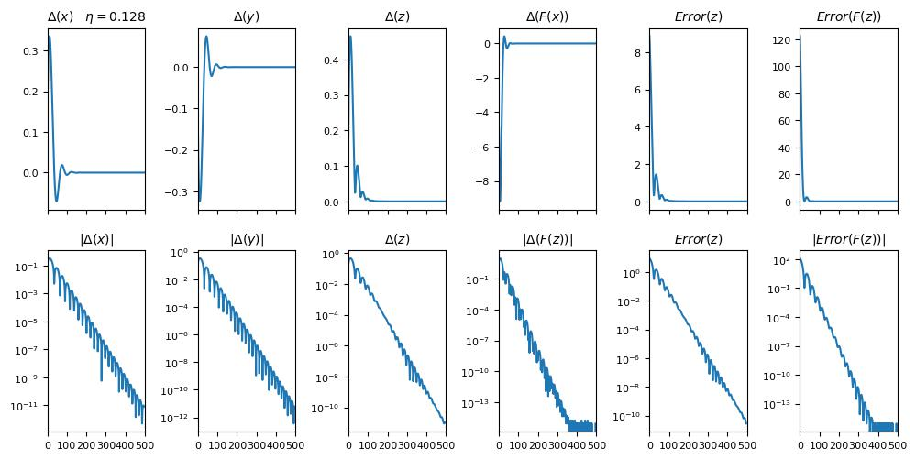
Adam method example (16)

Slide 47
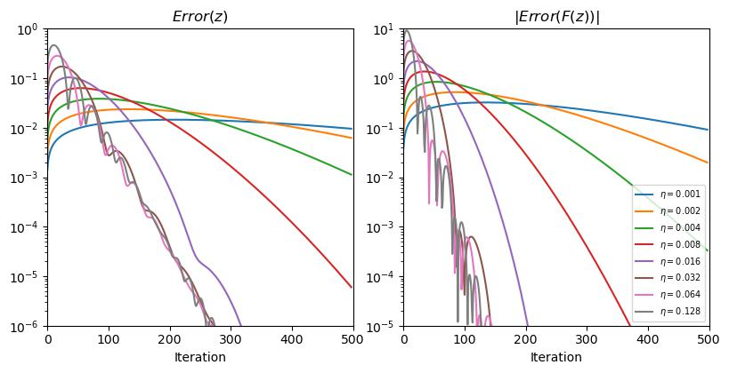
Adam method example (17)

Slide 48
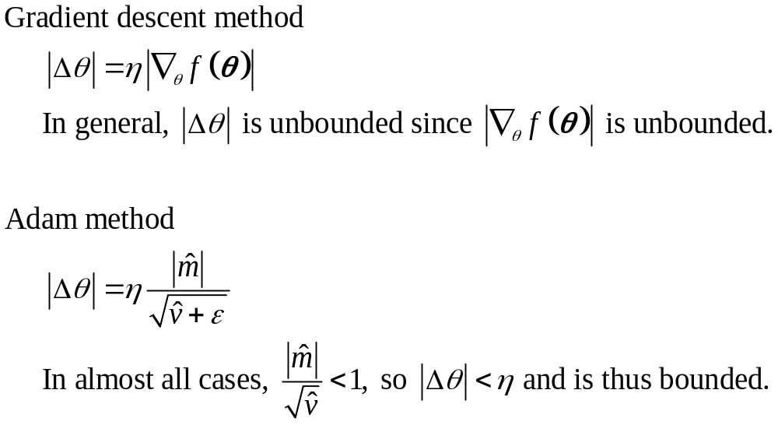
The key is managing the step size

